Slide 1
Boundary Value Problems and Eigen Value presented by: Babin Bista

Slide 2
Boundary Value Problem
If we specify the condition at different values of independent variables, such problem are called Boundary value problem.
Y=ae^x
If y(0)=ae^0=a;
If y(1)=ae
Y(0)+y(1)=2 then problem is Boundary value problem.
a(1+e)=2 => a=2/(1+e)

Slide 3
Standard Form of Two-Point Boundary Value Problem
In total, there are n₁+n₂=N boundary conditions.

Slide 4
What are eigen values?
Given a matrix, A, x is the eigenvector and λ is the corresponding eigenvalue if Ax = λx
A must be square and the determinant of A - λ I must be equal to zero
Ax - λx = 0 iff (A - λI) x = 0
Trivial solution is if x = 0
The nontrivial solution occurs when det(A - λI) = 0
Are eigenvectors unique?
If x is an eigenvector, then βx is also an eigenvector and λ is an eigenvalue
A(βx) = β(Ax) = β(λx) = λ(βx)

Slide 5
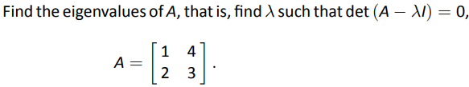
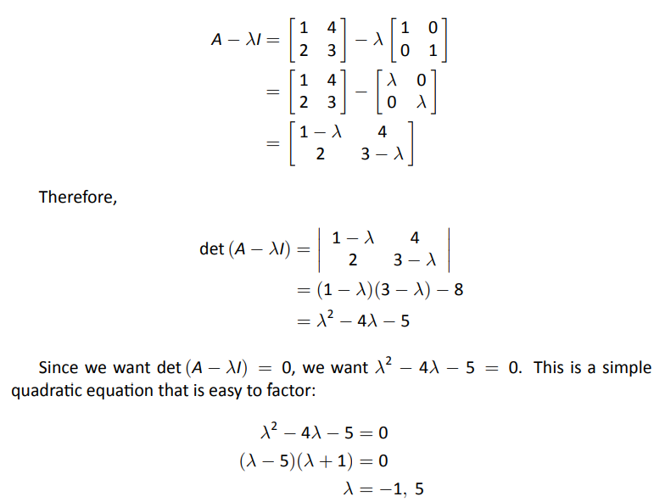
Example
Problem
Solution

Slide 6
Example, Eigenvalue Problem
λ is also unknown.

Slide 7
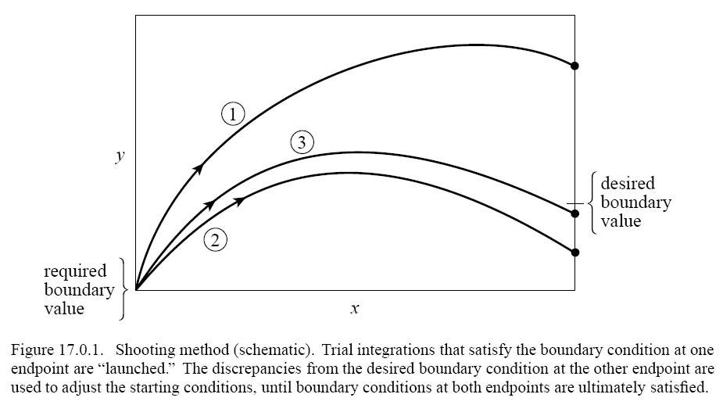
Shooting Method
Use Newton-Raphson to get the target

Slide 8
The Shooting Method (start)
At the starting point x₁ we have n₁ conditions to satisfy, thus we have n₂=N-n₁ freely variable starting parameters
Let
be the initial values of y which is parametrized by n₂ V-values without constraint.

Slide 9
The Shooting Method (discrepancy)
Using any standard ODE solver to find the solution at x₂. Compute a difference between the required boundary condition and actual value:
Our objective is to search the root of F with respect to V.

Slide 10
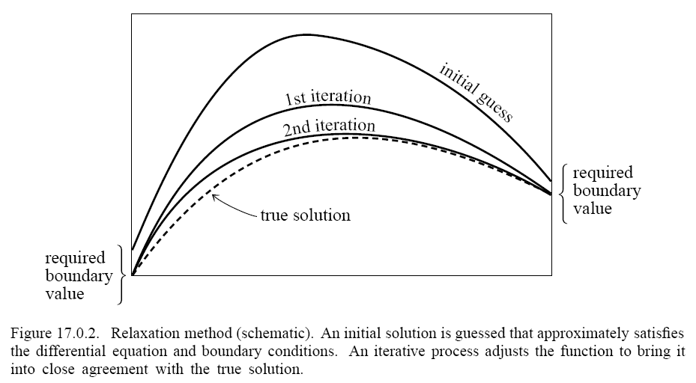
Relaxation Methods
Work with finite differences

Slide 11
Difference Method
Consider
Discretize the interval x_{j}=a+jh and equation
The difference equations form a linear system Ay = b if the equation is linear.

Slide 12
Thank you !!!

